Slide 1
Big Mountain Ski Resort
Kiman Park – Data Scientist
Jimmy blackburn – direction of operations
Alesha Eisen – database manager

Slide 2
Introduction
The client, Big Mountain Resort, recently bought an additional chair lift ($1,540,000 increase in operating cost this season) and is looking to capitalize on its facilities as much as possible. Furthermore, data-driven strategies are needed for better ticketing prices.
There are two considerations:
Based on the uniqueness of the facility, what should be the ticketing price?
The objective: Increase the ticketing price by 10% to increase the revenue.
By exploring the data and different scenarios, reduce the operation cost.
The objective: Decrease the operation cost by 10% without affecting the ticket price to increase the revenue.
To achieve these objectives, we need to explore the data first

Slide 3
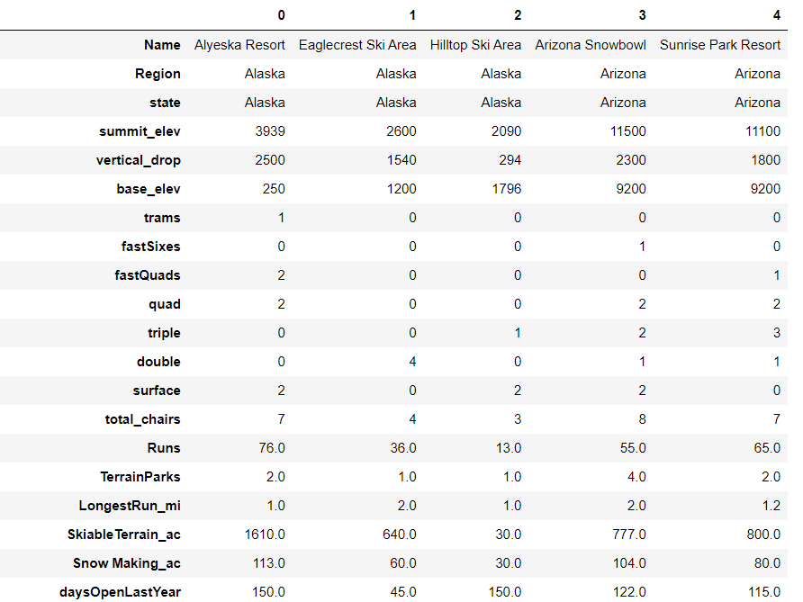
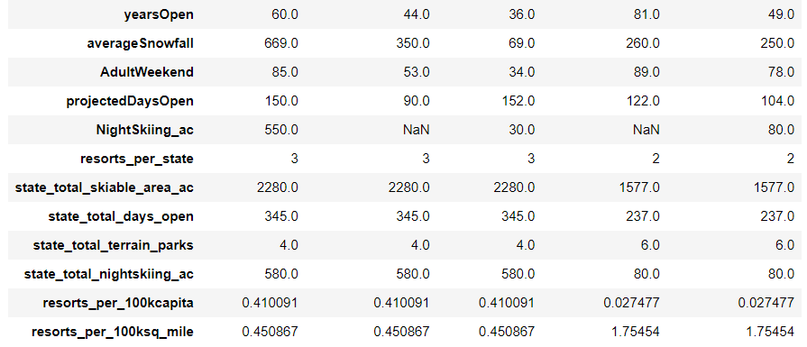
Ski resort data and state-wide data
The data includes 330 entries (rows) and 27 features (columns) about ski resorts in various regions and states in the United States.
We supplemented the ski resort data with the population data in Wikipedia.

Slide 4
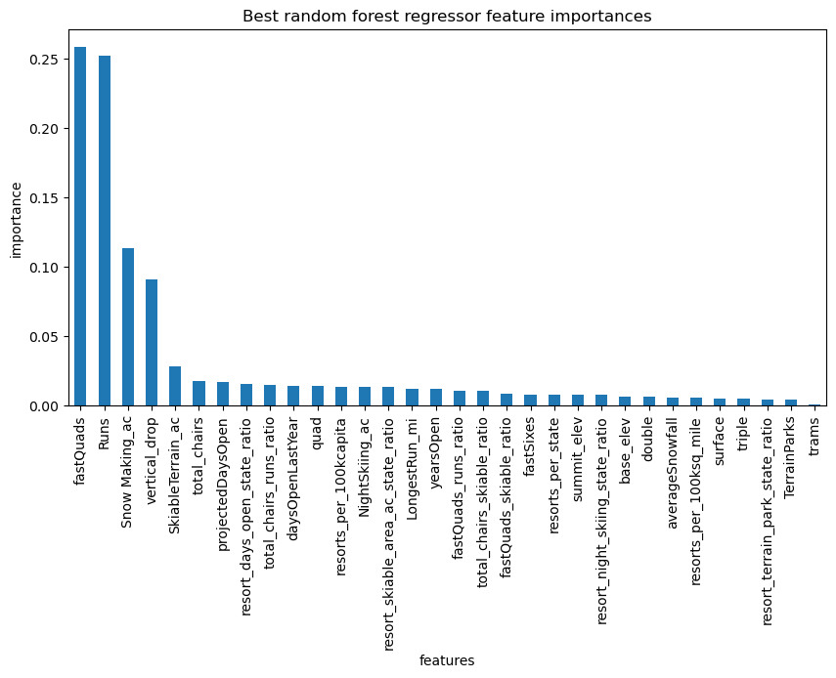
Key findings
Top 5 features associated with ticket price:
FastQuads – Number of four person chairs.
Runs – Count of the number of runs on the resort.
Snow Making_ac – Total area covered by snow making machines in acres.
vertical_drop – Vertical change in elevation from the summit to the base in feet.
SkiableTerrain_ac – Total skiable area in square acres.
Recommendations based on simulations:
Increase runs, vertical drop, and total chairs.
Decrease the snow making coverage and the longest run.

Slide 5
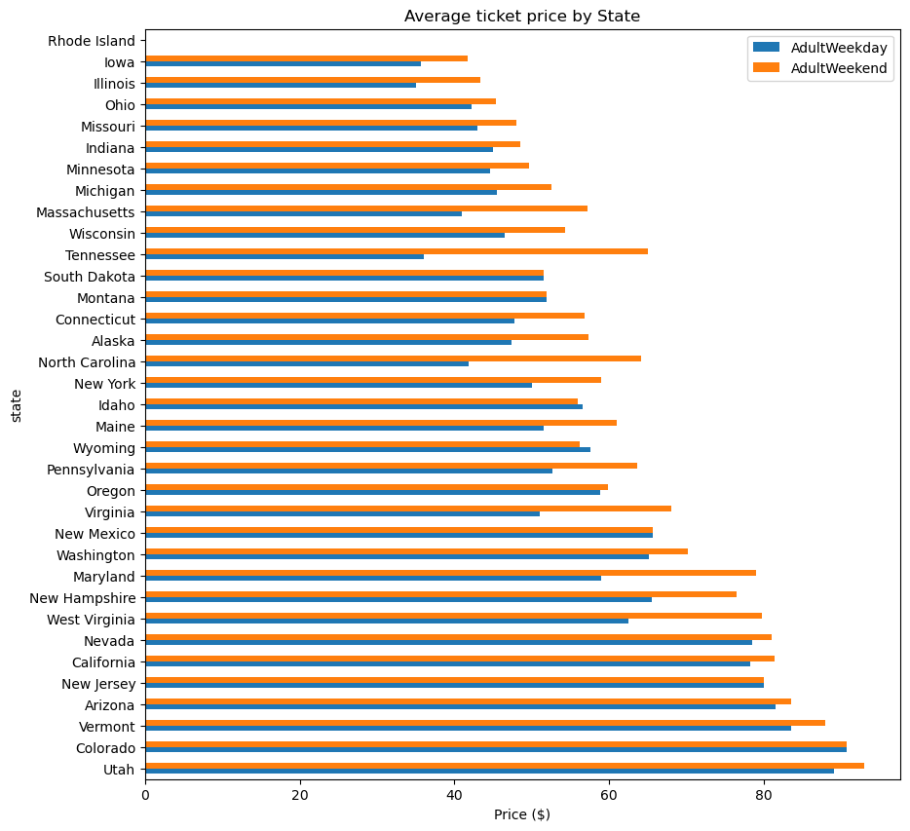
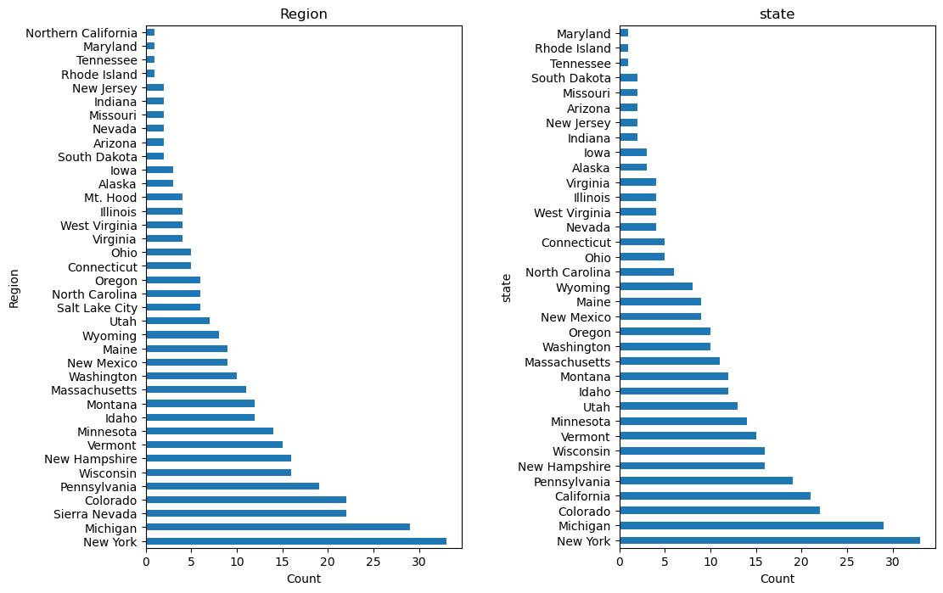
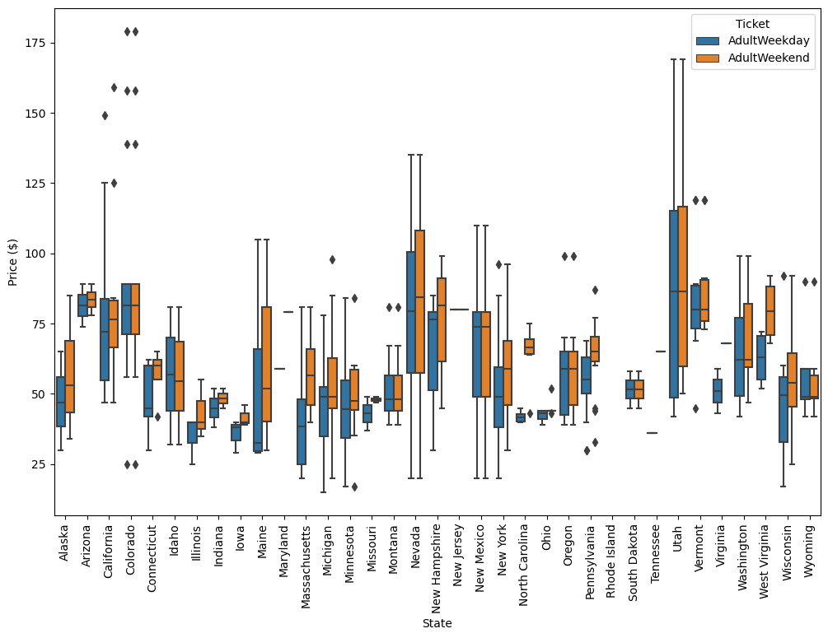
Modeling results and analysis
The state and the region do not offer much insight.

Slide 6
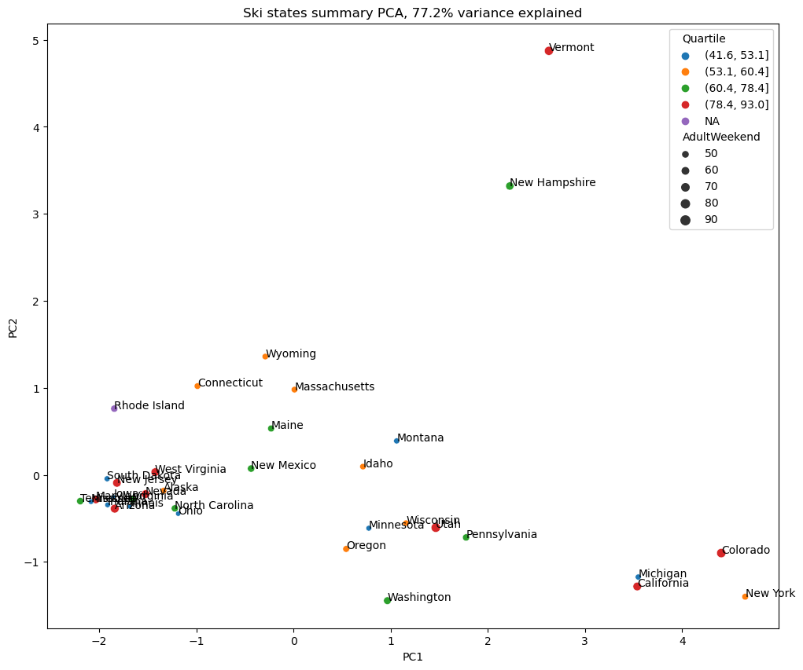
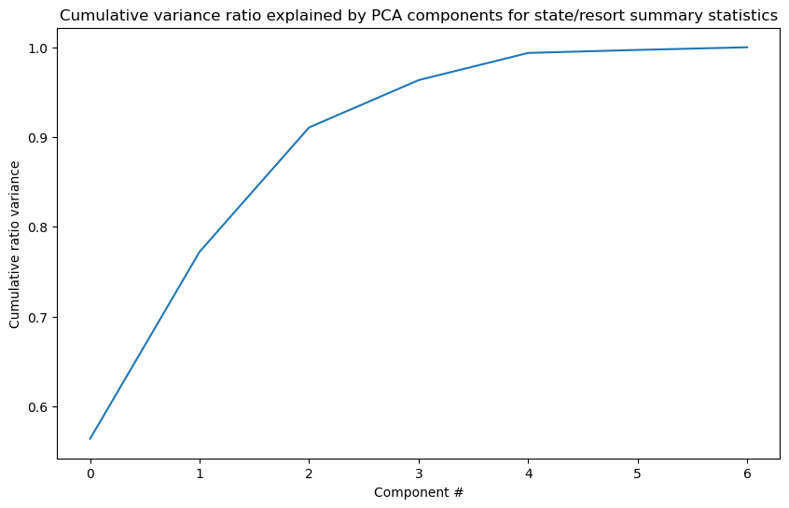
Modeling results and analysis
First step: scaled the data using PCA transformation

Slide 7
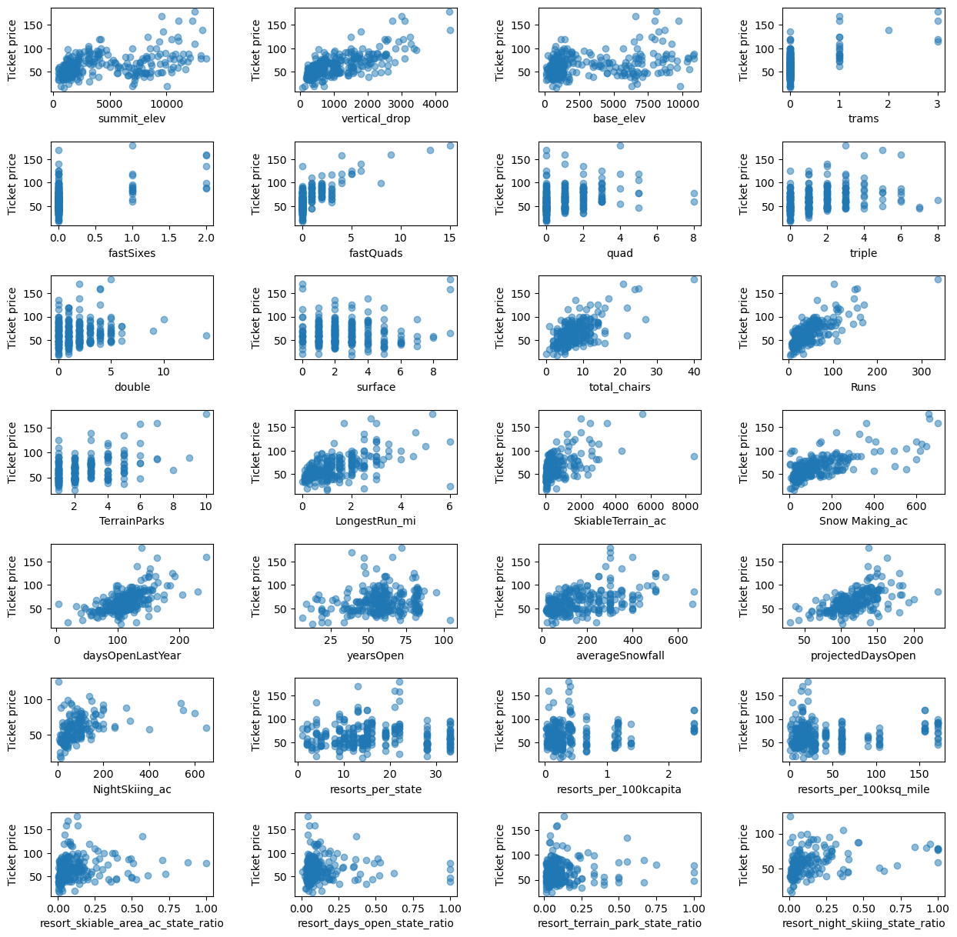
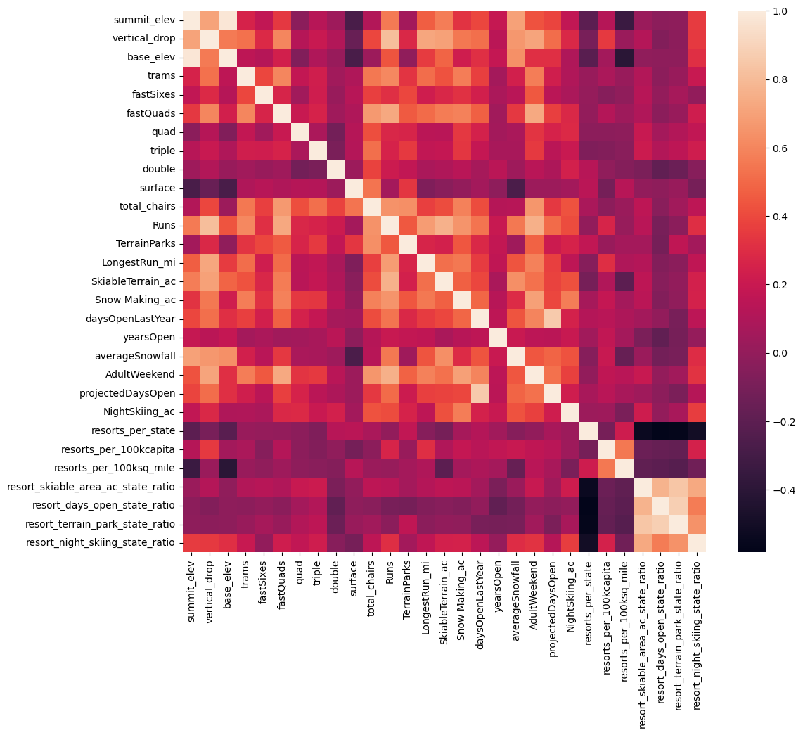
Modeling results and analysis
Second step: Correlations!
AdultWeekend is correlated with fastQuads, Runs, and Snow Making_ac, total_chairs, vertical_drop and resort_night_skiing_state_ratio.

Slide 8
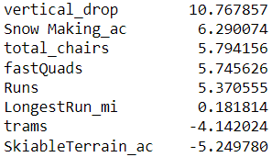
Modeling results and analysis
Fourth step: Linear vs. Random Forest regression.
Training/test split: 70% training and 30% test sets
Mean price = 63.811
Initial model:
Linear regression (median)
R² = 0.818 (training), 0.721 (test)
Mean absolute error = 8.54 (training), 9.41 (test)
Mean squared error = 111.89 (trainings), 161.73 (test)
Linear regression (mean)
R² = 0.817 (training), 0.716 (test)
Mean absolute error = 8.54 (training), 9.42 (test)
Mean squared error = 112.38 (trainings), 164.39 (test)
Pipeline: Linear regression with best k = 8
CV score (R², std) = 0.70, 0.0709
Important features:
Pipeline: Random Forest with best n estimators = 69
CV score (R², std) = 0.70, 0.0645
Important feature:
Random Forest model is selected due to the fact that R² is the same, but the standard of deviation is smaller.

Slide 9
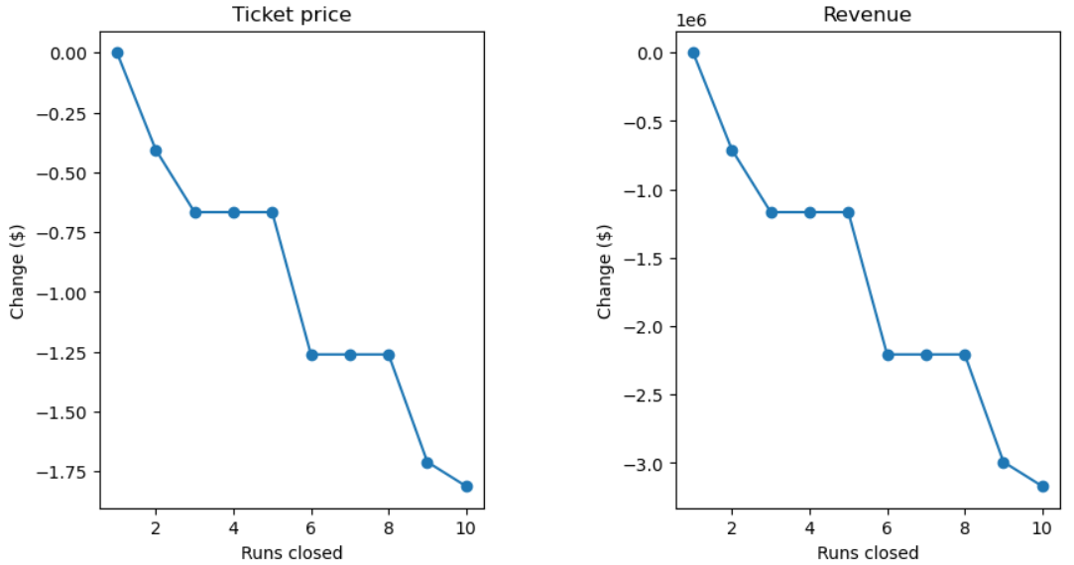
Simulations and conclusions
After running different scenarios/simulations with the Random Forest model:
Runs, vertical drop, and total chairs increase the ticketing price
Snow making and the length of the run do not affect the price.
Conclusions:
Create a strategy and budget to increase runs, vertical drops, and total chairs. However, decrease snow making and the length of the run to reduce operational cost
Collect and analyze the operational cost of individual equipment one-time cost for installation, and model a realistic model of the business.

